Slide 1

Azure architecture and services
AZ-900: Microsoft Azure Fundamentals

Slide 2

Exam objectives
Module 2.3 - Describe Azure storage services
Compare Azure storage services
Describe storage tiers
Describe redundancy options
Describe storage account options and storage types
Identify options for moving files, including AzCopy, Azure Storage Explorer, and Azure File Sync
Describe migration options, including Azure Migrate and Azure Data Box

Slide 3
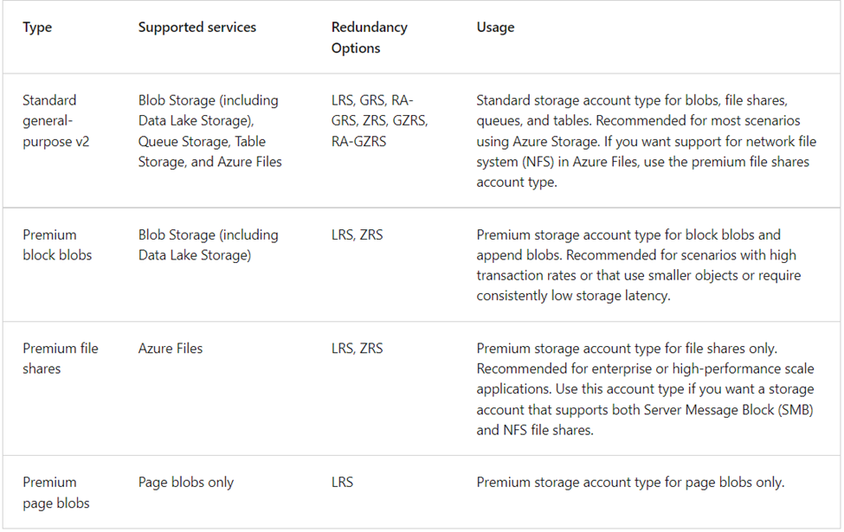
Azure Storage Accounts
A storage account provides a unique namespace for your Azure Storage data that's accessible from anywhere in the world over HTTP or HTTPS. Data in this account is secure, highly available, durable, and massively scalable.
The storage account represents a shared pool of storage that can be used to deploy storage resources.

Slide 4

Benefits of Azure Storage
Why should you move to Azure Storage?
Durable and highly available: Redundancy ensures that your data is safe if transient hardware failures occur.
Secure: All data written to an Azure storage account is encrypted by the service.
Scalable: Azure Storage is scalable to meet the data storage and performance needs of today's applications.
Managed: Azure handles hardware maintenance, updates, and critical issues for you.
Accessible: Data in Azure Storage is accessible from anywhere in the world over HTTP or HTTPS.
Image source: https://www.c-sharpcorner.com/article/azure-blob-storage-get-started-with-examples/

Slide 5
Azure Storage - discussion
What should you consider when creating Azure storage account name?
Choose a unique name for your storage account.Storage account name must be globally unique across Azure.
Storage account names must be between 3 and 24 characters in length and may contain numbers and lowercase letters only.
Select the appropriate region for your storage account.
Can you change Azure storage account name?
No, you cannot change the storage account name, Azure region, or the performance type of the storage.
Mention some Azure storage services.
Blob storage
Data Lake Storage Gen 2
Azure Files
Queue storage
Table storage
Notes:
Storage account names must be between 3 and 24 characters in length and may contain numbers and lowercase letters only.
Your storage account name must be unique within Azure. No two storage accounts can have the same name. This supports the ability to have a unique, accessible namespace in Azure.

Slide 6

Azure storage redundancy
Azure Storage always stores multiple copies of your data so that it is protected from planned and unplanned events such as:
transient hardware failures
network or power outages
natural disasters
Redundancy ensures that your storage account meets its availability and durability targets even in the face of failures.
Image source: https://medium.com/@cloud.devops.enthusiast/azure-storage-bc76a7057417
Notes:
How your data is replicated in the primary region.
Whether your data is replicated to a second region that is geographically distant to the primary region, to protect against regional disasters.
Whether your application requires read access to the replicated data in the secondary region if the primary region becomes unavailable.

Slide 7
Azure storage redundancy - Breakout Room Activity (20 mins)
Work with your team on preparing a five minutes presentations on the following topics:
Group 1: Redundancy in the primary region
Group 2: Redundancy in a secondary region
Group 3: Geo-redundant storage
Group 4: Geo-zone-redundant storage
Group 5: Read access to data in the secondary region
Q: Which type of storage is recommended by Microsoft in the primary region for Azure Data Lake Storage Gen2, Azure Files workloads?
A: Zone-redundant storage

Slide 8
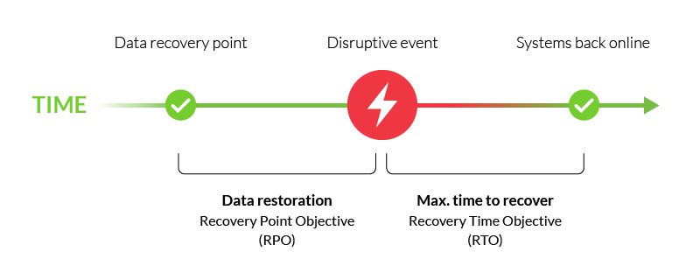
Azure storage redundancy
Recovery Point Objective (RPO)
The interval between the most recent writes to the primary region and the last write to the secondary region is known as the recovery point objective.
RPO indicates the point in time to which data can be recovered.
The Azure storage platform typically has an RPO of less than 15 minutes, although there’s currently no SLA on how long it takes to replicate data to the secondary storage.
https://www.imperva.com/learn/availability/recovery-point-objective-rpo/

Slide 9
Azure data migration options
Azure Migrate is a service that helps you migrate from an on-premises environment to the cloud.
Azure Migrate hub includes the following tools to help with migration:
Discovery and assessment: Discover and assess on-premises servers running on VMware, Hyper-V, and physical servers in preparation for migration to Azure.
Server Migration: Migrate VMware VMs, Hyper-V VMs, physical servers, other virtualized servers, and public cloud VMs to Azure.
Data Migration Assistant: is a stand-alone tool to assess SQL Servers. It helps pinpoint potential problems blocking migration.
Azure Database Migration Service: Migrate on-premises databases to Azure VMs running SQL Server, Azure SQL Database, or SQL Managed Instances.
Web app migration assistant: is a standalone tool to assess on-premises websites for migration to Azure App Service.
Azure Data Box “Open discussion”

Slide 10
Exam objectives
Module 2.4 - Azure identity, access, and security
Describe directory services in Azure
Describe authentication methods in Azure
Describe external identities and guest access in Azure
Describe Azure AD Conditional Access
Describe Azure role-based access control (RBAC)
Describe the concept of Zero Trust
Describe the purpose of the defense in depth model
Describe the purpose of Microsoft Defender for Cloud

Slide 11
Azure Active Directory
Azure AD is Microsoft's cloud-based identity and access management service. With Azure AD, you control the identity accounts, but Microsoft ensures that the service is available globally.
When you secure identities on-premises with Active Directory, Microsoft doesn't monitor sign-in attempts. When you connect Active Directory with Azure AD, Microsoft can help protect you by detecting suspicious sign-in attempts at no extra cost
Who uses Azure AD?
IT administrators
App developers
Users
Online service subscribers

Slide 12
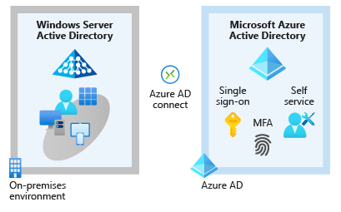
What services does Azure AD provide?
Authentication
Single sign-on
Application management
Device management
Connecting Active Directory with Azure AD
Azure AD Connect synchronizes user identities between on-premises Active Directory and Azure AD
Azure AD Connect synchronizes changes between both identity systems, so you can use features like SSO, multifactor authentication
Notes:
SSO enables you to remember only one username and one password to access multiple applications.

Slide 13
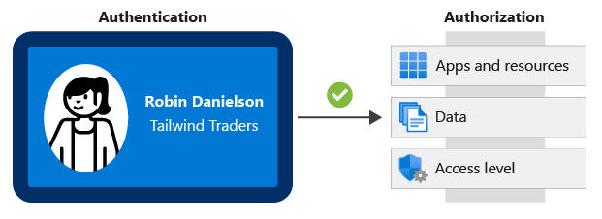
Authentication and Authorization
Authentication is the process of establishing the identity of a person or service that wants to access a resource. Proving you are who you claim to be.
Authorization is the process of establishing what level of access an authenticated person or service has. It specifies what data they're allowed to access and what they can do with it.

Slide 14
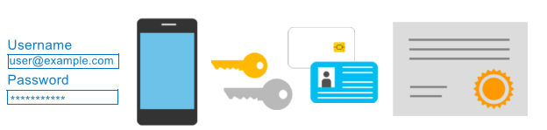
Multifactor Authentication
Multifactor authentication is a process where a user is prompted during the sign-in process for an additional form of identification.
When you sign in to websites, email. In addition to your username and password, you would be asked to enter a code that was sent to your phone
These additional elements fall into three categories:
Something the user knows : an email address and password
Something the user has: a code that's sent to the user's mobile phone
Something the user is : biometric property, such as a fingerprint or face scan
With multifactor authentication enabled, an attacker who has a user's password would also need to have possession of their phone or their fingerprint to fully authenticate

Slide 15
Passwordless authentication
Passwordless authentication methods are more convenient because the password is removed and replaced with something you have, plus something you are, or something you know
Microsoft global Azure and Azure Government offer the following three passwordless authentication options that integrate with Azure Active Directory (Azure AD)
Windows Hello for Business
Microsoft Authenticator app
FIDO2 security keys

Slide 16
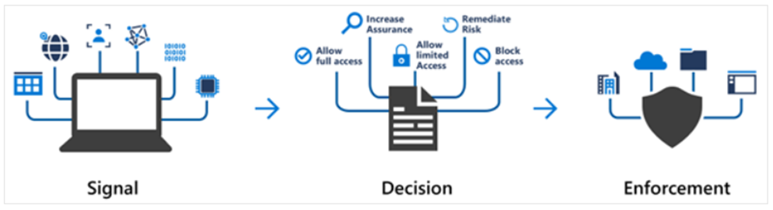
What's Conditional Access?
Conditional Access is a tool that Azure Active Directory uses to allow (or deny) access to resources based on identity signals. These signals include:
who the user is
where the user is
and what device the user is requesting access from
During sign-in, Conditional Access collects signals from the user, makes decisions based on those signals, and then enforces that decision by allowing or denying the access request or challenging for a multifactor authentication response

Slide 17
Using Azure role-based access control (RBAC)
Azure provides built-in roles that describe common access rules for cloud resources.
You can also define your own roles. Each role has an associated set of access permissions that relate to that role.
When you assign individuals or groups to one or more roles, they receive all of the associated access permissions.
When you assign the Owner role to a user at the management group scope, that user can manage everything in all subscriptions within the management group
When you assign the Reader role to a group at the subscription scope, the members of that group can view every resource group and resource within the subscription.
When you assign the Contributor role to an application at the resource group scope, the application can manage resources of all types within that resource group, but not other resource groups within the subscription
Azure RBAC is enforced on any action that's initiated against an Azure resource that passes through Azure Resource Manager.

Slide 18
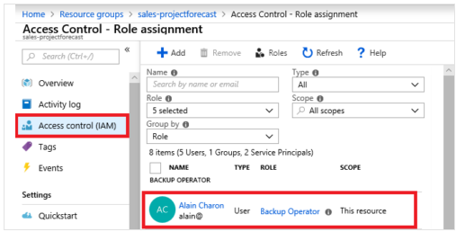
Managing Azure RBAC permissions?
You manage access permissions on the Access control (IAM) pane in the Azure portal
In this example, Alain Charon has been assigned the Backup Operator role for this resource group.

Slide 19
Managing Azure RBAC permissions?
You manage access permissions on the Access control (IAM) pane in the Azure portal
In this example, Alain Charon has been assigned the Backup Operator role for this resource group.

Slide 20
Zero trust model
Zero Trust is a security model that assumes the worst case scenario and protects resources with that expectation. Zero Trust assumes breach at the outset, and then verifies each request as though it originated from an uncontrolled network.
Verify explicitly - Always authenticate and authorize based on all available data points.
Use least privilege access - Limit user access with Just-In-Time and Just-Enough-Access (JIT/JEA), risk-based adaptive policies, and data protection.
Assume breach - Minimize blast radius and segment access. Verify end-to-end encryption. Use analytics to get visibility, drive threat detection, and improve defenses.

Slide 21
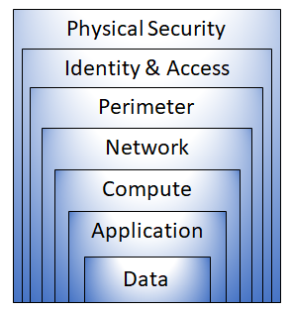
Defense in depth
The objective of defense in depth is to protect information and prevent it from being stolen by those who aren't authorized to access it.
The strategy uses a series of mechanisms to slow the advance of an attack
- The physical security layer is the first line of defense to protect computing hardware in the datacenter.
- The identity and access layer controls access to infrastructure and change control.
- The perimeter layer uses distributed denial of service (DDoS) protection to filter large-scale attacks before they can cause a denial of service for users.
- The network layer limits communication between resources through segmentation and access controls.
- The compute layer secures access to virtual machines.
- The application layer helps ensure that applications are secure and free of security vulnerabilities.
- The data layer controls access to business and customer data that you need to protect.

Slide 22

References:
https://docs.microsoft.com/en-us/learn/modules/azure-database-fundamentals/
https://www.youtube.com/watch?v=gIhf-S7BCdo&list=PLGjZwEtPN7j-Q59JYso3L4_yoCjj2syrM&index=10
https://www.linkedin.com/learning/paths/prepare-for-the-azure-fundamentals-certification-az-900

